Slide 1
WEB ACCESSIBILITY TESTING
Why You Should Care And What You Can Do About It
may 2019
Lorena cortada

Slide 2
AGENDA
What is web accessibility
Types of disabilities
WCAG 2.1
tips for accessibility tests
TOOLS
Why Build Accessible Websites?
Q&A

Slide 3

WHAT IS WEB ACCESSIBILITY
Notes:
Web accessibility basically means that people with disabilities can use the Web. Can perceive, understand, navigate, and interact with the Web.
While access to people with disabilities is the primary focus of web accessibility, it also benefits people without disabilities. For example, a key principle of web accessibility is designing websites that are flexible to meet different user needs. This flexibility also increases general usability and lets people without disabilities use websites according to their preferences, such as using whichever browser they want and using keyboard shortcuts.

Slide 4
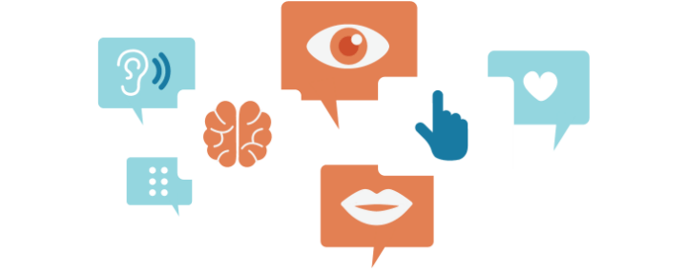
TYPES OF DISABILITIES
VISUAL
AUDITORY
AMBULATORY
COGNITIVE
Text Blindness, low vision, color-blindness.
No sight (or extremely low vision).
Difficulty distinguishing low contrast text, small text, graphic and colors.
Total deafness or partial loss of hearing.
Difficult or complete inability to hear sounds.
Condition that impairs a person's physical movements.
Difficulty or inability to use hands. Possible tremors in hands, making it difficult or impossible to use a mouse especially. Possible slow movements in hands.
Possible limited comprehension of abstract concepts, text and math.
Possible cognitive overload with large amounts of information.
Possible attention deficit or distractibility.

Slide 5



TYPES OF DISABILITIES
Low vision

Slide 6
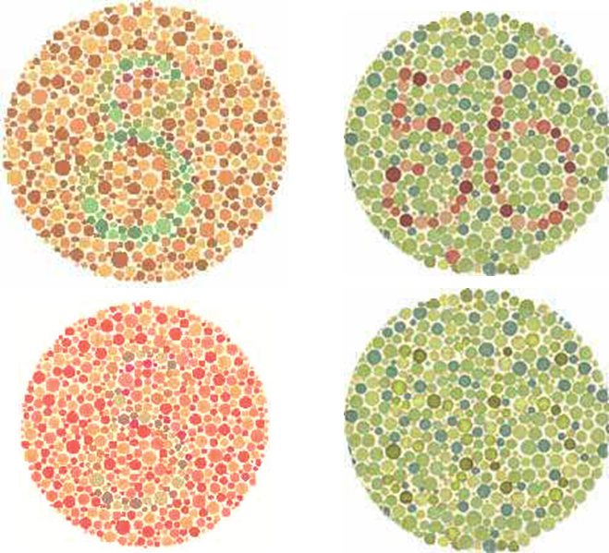
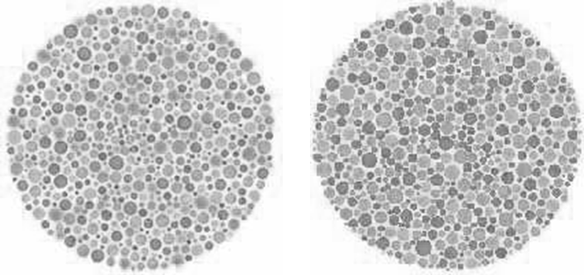
TYPES OF DISABILITIES
Color-Blindness (Color combinations examples)

Slide 7
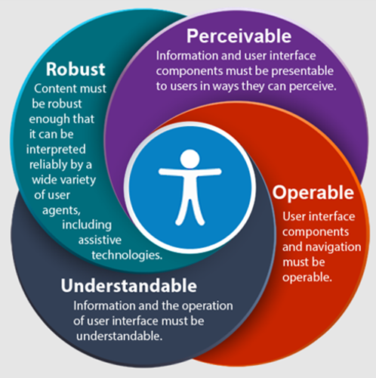
WEB CONTENT ACCESSIBILITY GUIDELINES (WCAG) 2.1
https://www.w3.org/TR/WCAG21/
Notes:
WCAG is primarily intended for:
-Web content developers (page authors, site designers, etc.)
-Web authoring tool developers
-Web accessibility evaluation tool developers
-Others who want or need a standard for web accessibility, including for mobile accessibility

Slide 8
AGENDA
What is web accessibility
Types of disabilities
WCAG 2.1
tips for accessibility tests
TOOLS
Why Build Accessible Websites?
Q&A

Slide 9

TIPS FOR ACCESSIBILITY TESTS
Screen Reader (Blindness)
Keyboard (Motor Disabilities and Blindness)
Are names/labels announced?
Does the page allow for good structural navigation?
Can I navigate through native elements such as tables, links, list items, etc.?
Are states & changes announced?
Are status updates announced?
What happen if the page got automatically was refresh?
Does it work with the keyboard?
Is the order logical?
Does the keyboard focus follow the action?
Does keyboard focus get trapped?
TEXT
text

Slide 10

TIPS FOR ACCESSIBILITY TESTS
Screen MAGNIFICATION (Low Vision)
Do any changes occur far off the screen?
Audio and Video (Deafness & Blindness)
Can a deaf person understand it?
Can a blind person understand it?
Can a deaf-blind person understand it?
Timing (Motor Disabilities & Cognitive Disabilities)
Are users warned about timeouts, and can they extend them?
Do any objects move?
color (Color Blindness, Low Vision & Blindness)
text
text
TEXT
Are users able to read color texts on a colored background? (Titles, links, etc.)

Slide 11
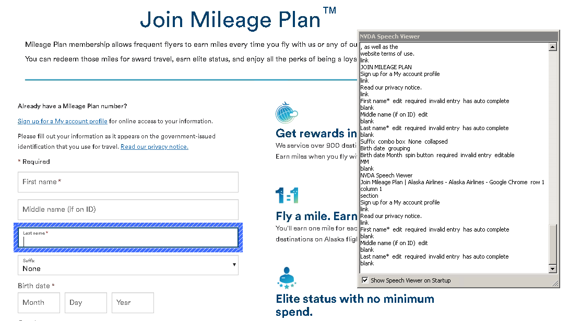
ACCESSIBILITY TOOLS
NVDA: Free Screen reader

Slide 12
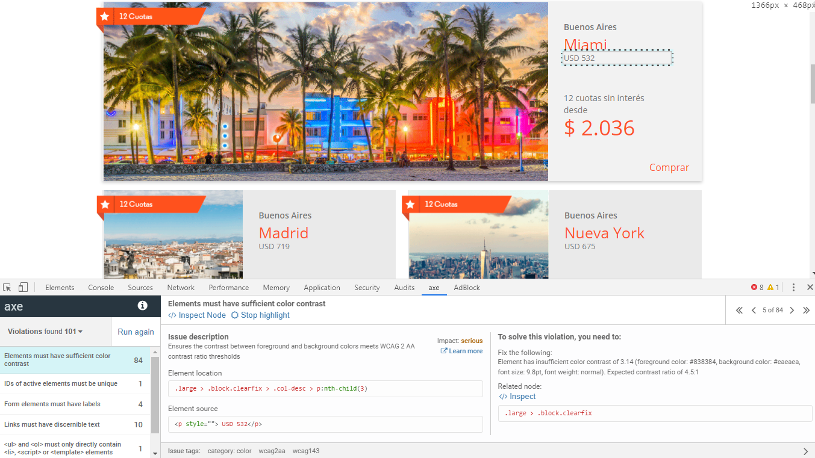
ACCESSIBILITY TOOLS
AXE: Chrome extension to find accessibility issues in a web page.

Slide 13
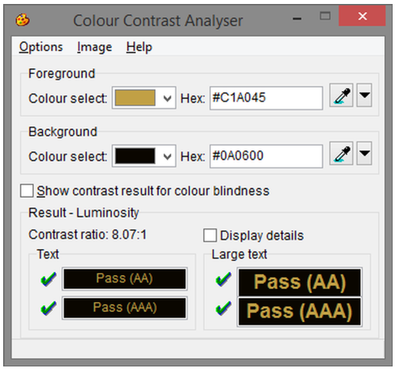
ACCESSIBILITY TOOLS
Colour Contrast Analyser

Slide 14

WHY BUILD ACCESSIBLE WEBSITES?
Notes:
-Support People with Disabilities
-Promote a Culture of Accessibility and Inclusion
-The Better Business Case
-Human Rights and the Law
-Reduce site development (in a long term) and maintenance time.
-Promote usability for all type of users.
Accessible websites can have better search results, reduced maintenance costs, increased audience reach, and demonstrate corporate social responsibility
(See video: https://www.youtube.com/watch?v=3f31oufqFSM )

Slide 15
Q&A
Lorena cortada

